Slide 1







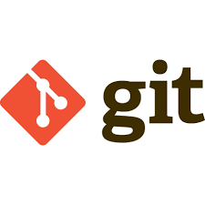
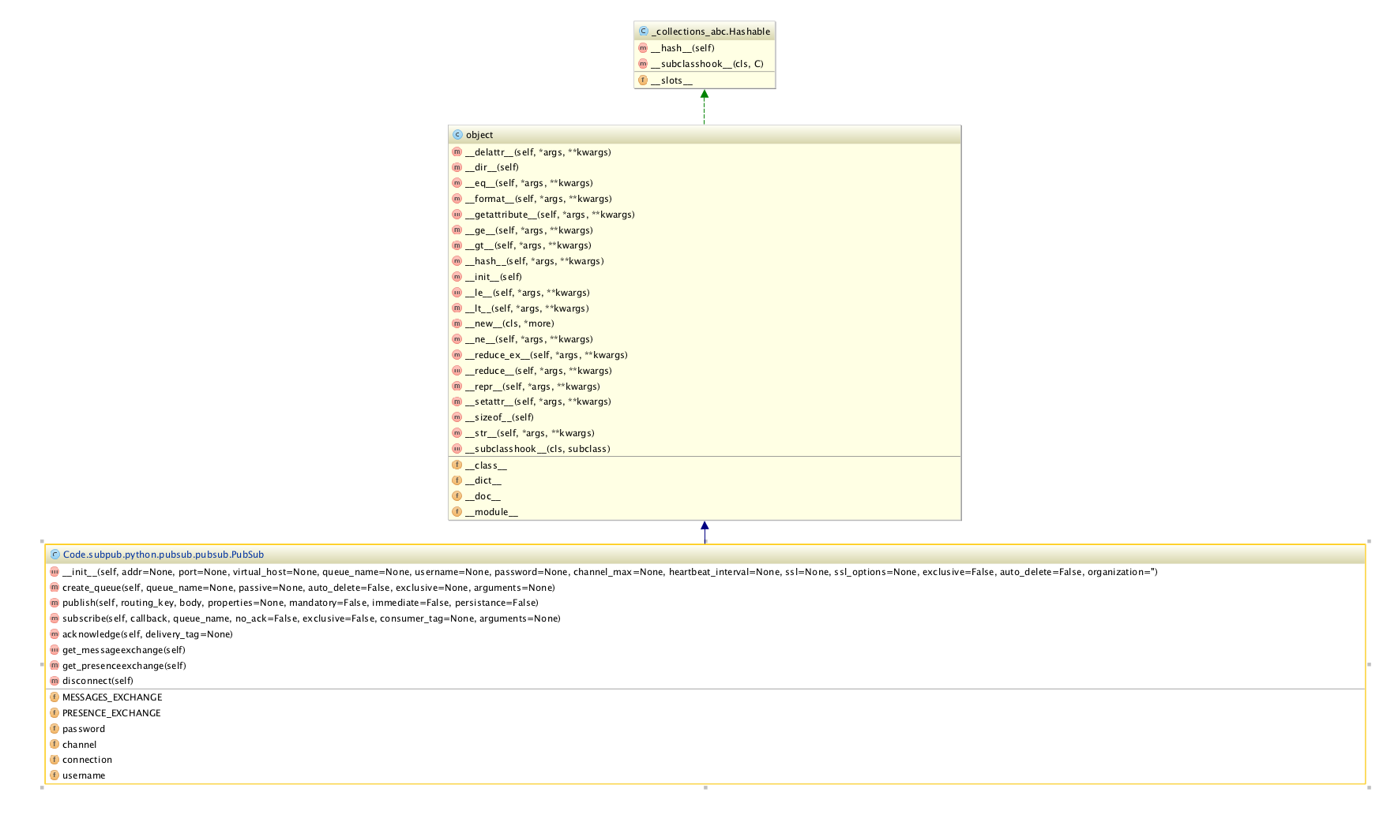
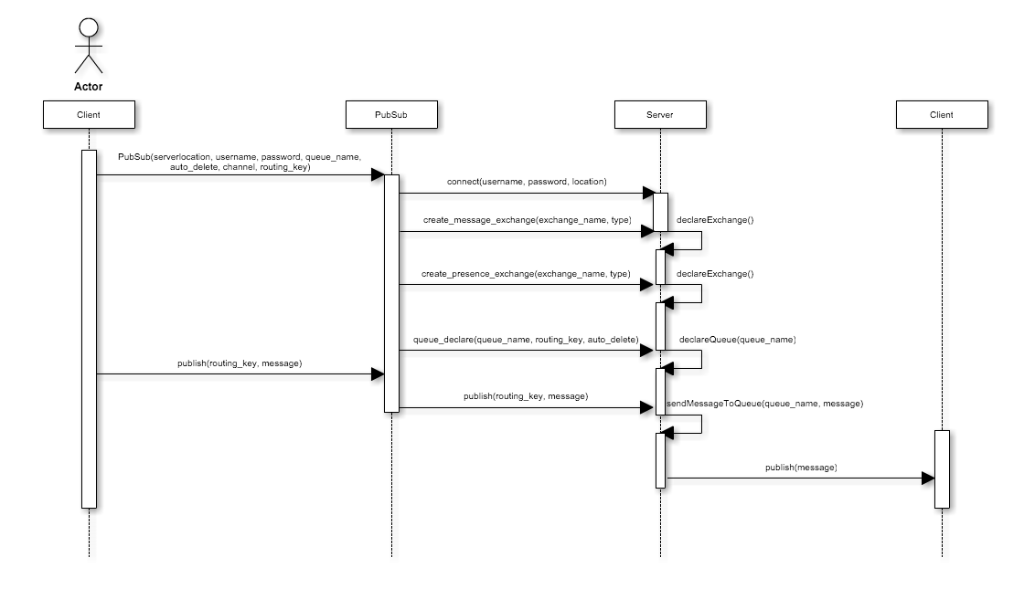
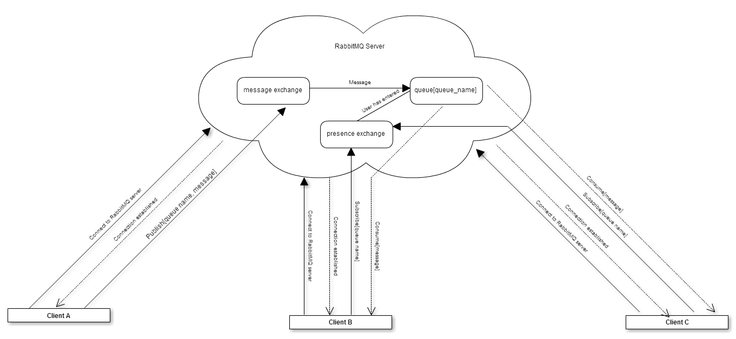
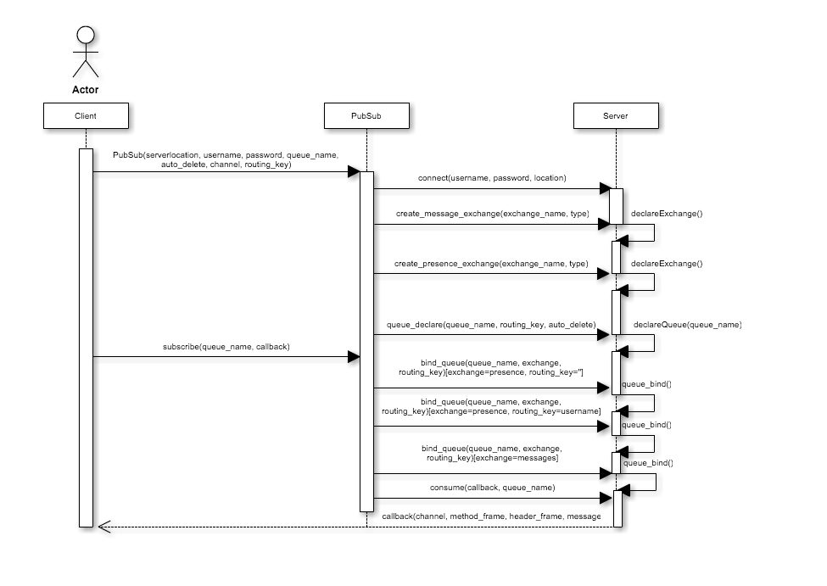
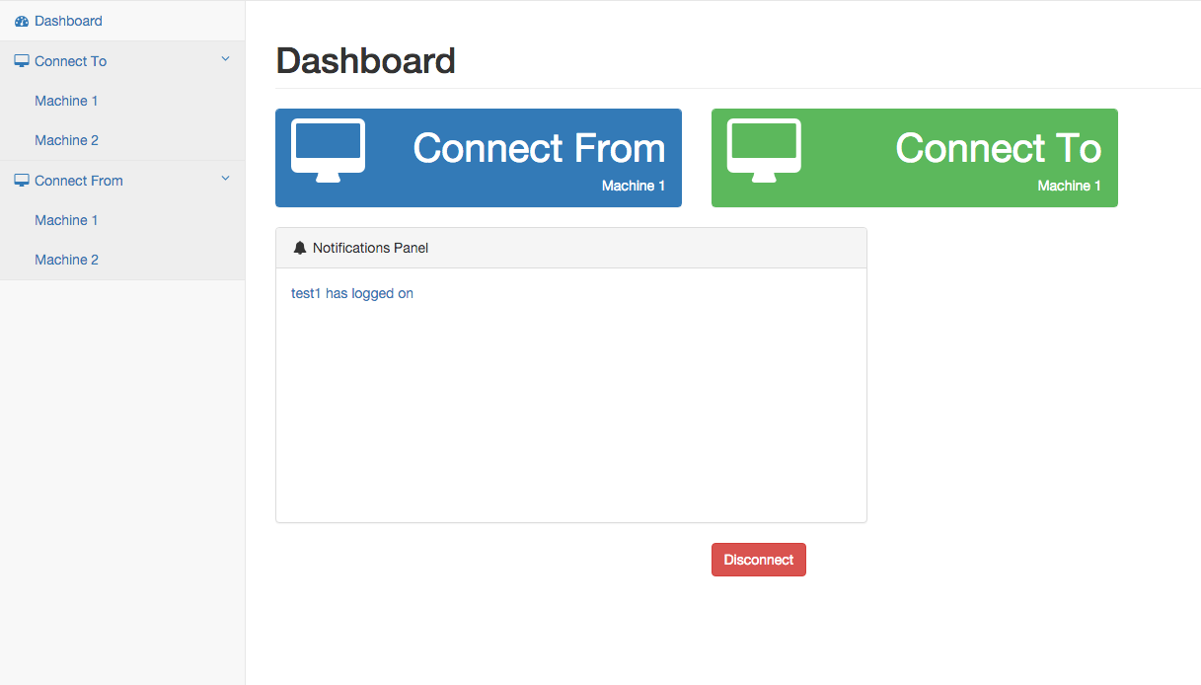
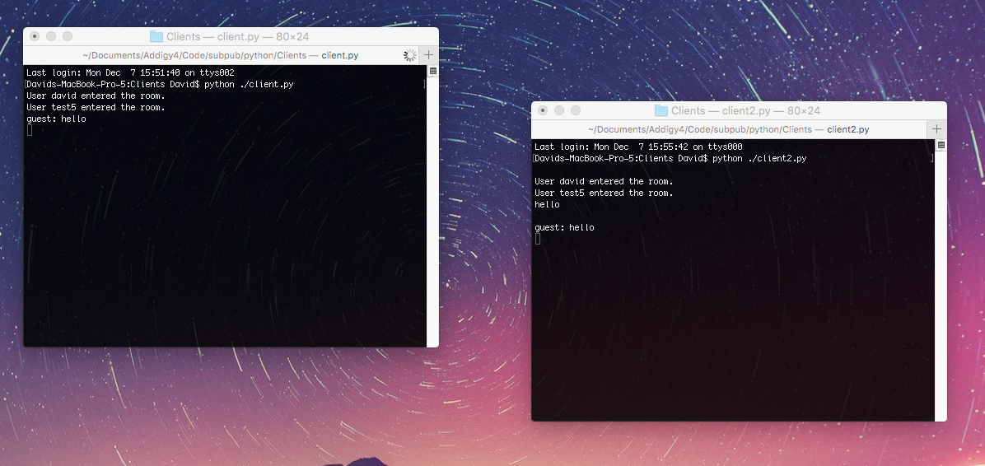
School of Computing & Information Sciences
Senior Project, 2015, Fall
PubSub
Student: David Romero, Florida International University
Mentor: Jason Dettbarn, Addigy
Instructor: Masoud Sadjadi, Florida International University
Problem
Current System
Requirements
Sending messages to multiple devices can prove to be cumbersome
A lot solutions not entirely scalable or very straight forward
Other solutions do not keep track who’s accessing a channel
Cost efficient model that can compete with more expensive ones
Addigy’s current model is made possible by using the paid server known as PubNub.
Currently RabbitMQ’s configuration can prove to be combuersome, having to meddle with a lot of different files and commands.
PubNub’s API’s are well known for being very user friendly, more so than RabbitMQ’s existing API’s
More so, obtaining presence in RabbitMQ is not as seamless as PubNub
PubSub should be able to successfully publish a message to a queue.
PubSub should be able to subscribe to a channel and receive messages
Should be simple to use and interface with the RabbitMQ server
Must allow for cross platform interaction with the server. That is, there should be a API available for desktop applications and one available for web applications.
Solution must be scalable
System Design
RabbitMQ server exchanges are the components that handle the actual distribution of the messages.
Messages are stored in queue available on the server
PubSub is a means to easily interface with the RabbitMQ server
Object Design
Implementation
PubSub relies heavily on a publish/subscribe design. This done to decouple methods, so that they wouldn’t be so interdependant.
In addition, using AMQP we were able to send reliable messages and quick message delivery.
Sequence of events for a publish
Screenshots
Verification
Sequence of events for a subscribe
In order to verify PubSub’s behavior, various different clients were devised to manually test a set number of features
Using RabbitMQ’s existing management capabilities, interaction with the server was closely followed.
Developer tools in the browser and IDE helped track what headers were being received by PubSub, faulty Javaascript and Python, formatting errors, etc.
Summary
A scalable, easy to use publish/subscribe
Crafted a personalized experience.
Multiplatform solution; clients can choose to implement a either a desktop or web solution.
Solutions are properly able to interface.
Implementing clients are aware who has entered/exited a channel.
An example of an application implementing the web solution
A desktop client using the python solution
Acknowledgement
The material presented in this poster is based upon the work supported by Jason Dettbarn, Javier Carmona and Ayme Morrina. I am thankful to the help that I received from my group member Carlos Ruiz

